Slide 1
Tx Driver CML Vs VM
1 Gbps
Muhammad Aldacher

Slide 2
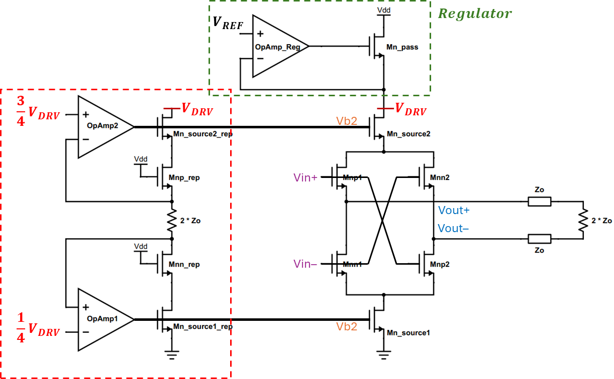
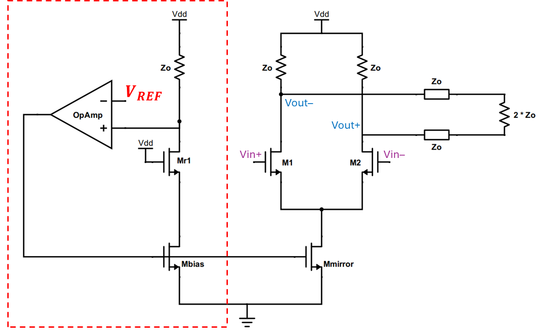
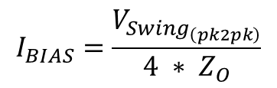
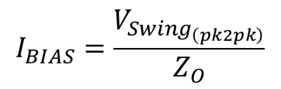


Current-Mode
Voltage-Mode
$$V_{{Swing}_{(pk2pk)}}=V_{DD}−V_{REF}$$
$$V_{{Swing}_{(pk2pk)}}=V_{DRV}=V_{REF}$$
$$I_{BIAS}=\frac{V_{Swing_{\left(pk2pk\right)}}}{Z_{O}}$$
$$I_{BIAS}=\frac{V_{Swing_{\left(pk2pk\right)}}}{4 ∗ Z_{O}}$$

Slide 3
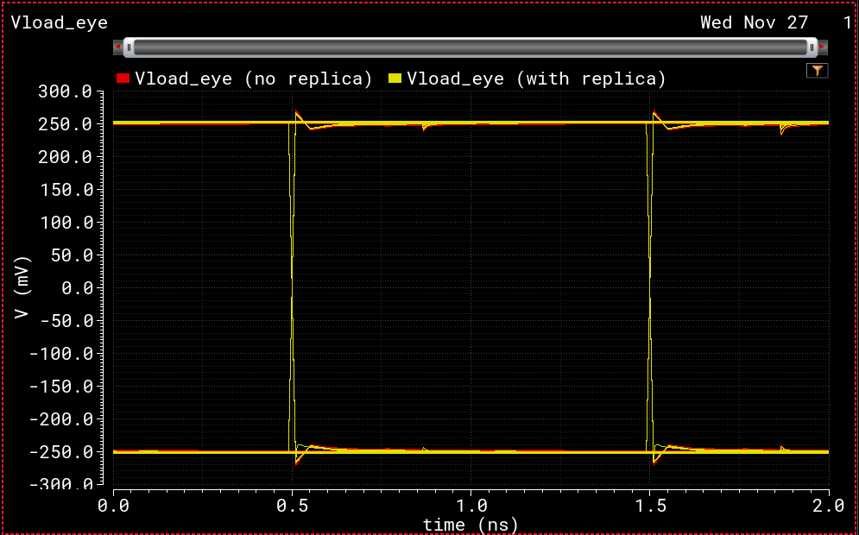
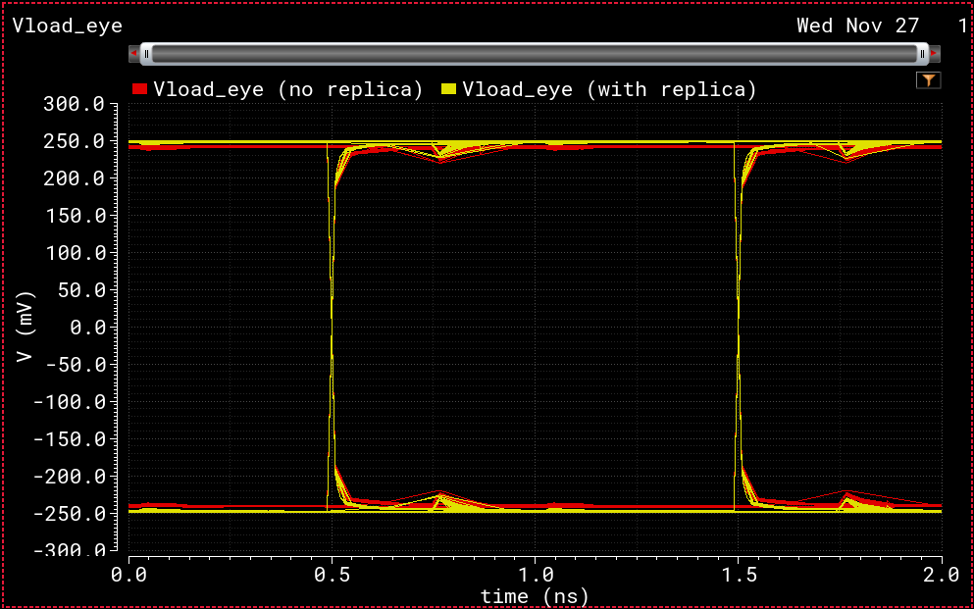
Current-Mode
Voltage-Mode
Replica provides slight improvement
Faster Rise & Fall times (Better for higher data-rates)
Better impedance & swing control
Replica provides significant improvement
Less Power consumption

Slide 4
From Simulations
Target Swing of 500 mV | CM driver | VM driver
Swing (without replica) | 496.18 mV | 478.16 mV
Swing (with replica) | 499.90 mV | 493.67 mV
Current Consumption | 20 mA | 5 mA

